Slide 1
Game Design Process
Introduction to Game Design and Development
ITCS 4230/5230
Dr. Dewan Tanvir Ahmed
Department of Computer Science
University of North Carolina at Charlotte

Slide 2
Objectives
Learn the common lifecycle models for
Software development and
Game design and development
Game Production Lifecycle
Anatomy of a Game designer

Slide 3
Terminology
Software development projects
Software design
Implementation (aka programming or coding)
Game production projects
Game Design
Development
Includes software design, implementation, etc.
Includes pre-production, production, etc.

Slide 4
SDLC
A software development process
aka Software Development Life-Cycle (SDLC)
It is a structure imposed on the development of a software product.

Slide 5
Software Process Framework
A structured set of activities required to develop a software system
Umbrella activities
Umbrella activities are applicable across entire software process.
Typically includes:
Project tracking and control
Risk management
Software quality assurance
Technical reviews
Measurement
Framework activities
actions
work tasks
work products
milestones & deliverables
QA checkpoints
Process Framework

Slide 6
Software Process Framework
A structured set of activities required to develop a software system
Activity: part of the project that
takes place over a duration of time
Umbrella activities
Framework activities
Milestone: a condition or event that is used to indicate progress
actions
work tasks
work products
milestones & deliverables
QA checkpoints
Deliverable: tangible result of project that is given to customers
Process Framework
Notes:
Milestone example: completion of an activity, approval of a deliverable, completion of a technical review
More specifically: Test plan review—test plans are adequate and we are now ready to test;

Slide 7
Framework Activities
Communication
Same set of framework activities will be applied to every project ...
…but the tasks (and degree of rigor) for each activity will vary based on:
the type of project
characteristics of the project
Planning
Modeling
Construction
Deployment

Slide 8
Software Process Models
Waterfall model
a.k.a. “classic life cycle”
Separate and distinct process activity phases, linear flow
Incremental process models
Complete a sequence of the process activities in linear fashion
Each pass results in deliverable piece of software
Evolutionary (iterative) process models
Each iteration through sequence of activities develops a limited prototype to extract feedback from customer
Notes:
Not every process model should be applied to every project. Each has characteristics which make them more or less applicable.
Codify different approaches to software process so that impose order on the potential chaos that lurks in software development projects.

Slide 9
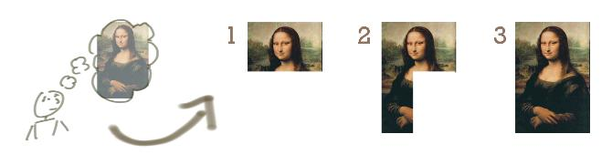
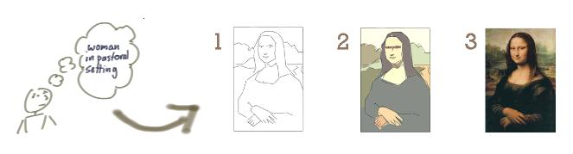
Incremental vs. Iterative Process Model - Analogy
Incremental development
Iterative development

Slide 10
Waterfall Model
1970s
Communication
Initiation
Requirements gathering
The waterfall model was first defined by Winston W. Royce in 1970
Planning
Estimating
Tracking
Modeling
Analysis
Design
Sequential workflow
Construction
Code
Test
Deployment
Delivery
Validation
Notes:
Introduced in 1970.
Issue: not really any guidance on how each phase should result in the generation of these artifacts
Used in US DoD contracts for many years
An example process for “big up front design”

Slide 11
Waterfall Model (cont.)
“Pure” waterfall –
complete each phase before moving to the next.
Linear progression through phases.
Document-driven -- each phase results in the production of an artifact (i.e. states progress). These are the deliverables.
Each completion of a phase is considered to be a milestone.
Results cascade (like a waterfall) into the next phase.

Slide 12
Waterfall Model (cont.)
Advantages of the waterfall model:
Most widely used software process model
Highly disciplined process of documentation
Easily observable development progress
Good for management control (plan, staff, track)
Easy to create budget
Consistent review process

Slide 13
Waterfall Model (cont.)
Disadvantages of the waterfall model:
No opportunity for iteration
No opportunity for feedback
Document centric - All requirements must be known upfront
Strict task dependencies reduces efficiencies (no parallel activities)
Takes a long time to get the product into the customer's hands which magnifies risk
Can give a false impression of progress
Not user centered –
Little opportunity for customer to preview the system

Slide 14
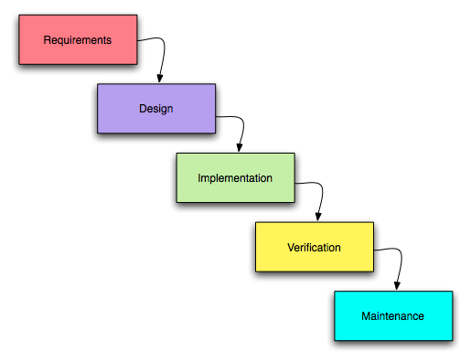
Waterfall Model (cont.)
When to use Waterfall Model
Requirements are very well known
Product definition is stable
Technology is well-understood
New version of an existing product is required

Slide 15
Incremental Process Models
Development and delivery split into increments
Each increment delivers part of required functionality as an operational product
Highest priority requirements in early increments
First increment is core product

Slide 16
Incremental Model
Basic idea
Waterfall model applied to an increment
increment n
…
software functionality
time
Notes:
Iterative vs. Incremental models (A. Cockburn): Iterative is planned rework; increment is an addition of functionality
Write on the board:
Iterative vs. Incremental models (Pfleeger):
Desired features: Document editing and file management, spell check, “templates”
Iterative delivers entire system in first iteration (some features are rudimentary) and then improves it (e.g., crappy versions of editing, spell check, and templates in v1, improved versions in v2, etc). (All layers are present)
Incremental introduces new features in each increment. (Add a layer each time)
Applicable when you have a solid understanding of the requirements, the requirements aren’t likely to change, but the software system is too large to design, implement, and deliver as one big chunk (it would take too long, for one thing)
If you are a long time user of Google docs, you have been a witness to the application of an incremental process model…new features have appeared over time.

Slide 17
Evaluating Incremental Development
Benefits
Early increments can help elicit requirements
Provide a functional system from first increment
Others?
Lower risk of overall project failure
Can work on the “core product” with small team, add people if needed if next increment is desired
Highest priority system services receive the most testing
Notes:
Other benefits:
Lower risk of overall project failure
Can work on the “core product” with small team, add people if needed if next increment is desired
Can plan increments to manage risks – a team member with certain expertise is unavailable for entire project, schedule tasks around him/her
Highest priority system services receive the most testing

Slide 18
Evolutionary (Iterative) Process Models
Designed to accommodate evolving business and product requirements
Iterative approach to software development
Produce some initial version of software functions
Review what you have and what you’ve learned
Refine and improve what you deliver
Software features evolve and become increasingly complete
Two common models:
Prototyping
Spiral Development Model
Notes:
Write on the board:
Useful when:
the requirements are unknown or expected to change
short time-to-market makes it impossible to deliver a full version of the product but some “lesser” version of the product must be delivered/sold to stay competitive
A set of core requirements are well understood but extensions/advanced features aren’t fully imagined or specified
Iterative vs. Incremental models (Pfleeger): Iterative delivers entire system in first iteration (some features are rudimentary) and then improves it (e.g., crappy versions of editing, spell check, and templates in v1, improved versions in v2, etc). Incremental introduces new features in each increment.
Iterative vs. Incremental models (A. Cockburn): Iterative is planned rework; increment is an addition of functionality that is
Iterative and incremental approaches can be complementary. You iteratively design increments and their integration

Slide 19
Evolutionary Process Models: Prototyping
Prototyping
Rapid (throw-away) prototyping
Objective: understand the system requirements
Start with poorly understood requirements
Exploratory development (a.k.a. evolutionary prototyping)
Objective: work with customers and evolve a final system
Start with well-understood requirements
Notes:
Useful when developers are unsure of the efficiency of an algorithm, adaptability or suitability of an operating system, or how the user should interact with the system

Slide 20
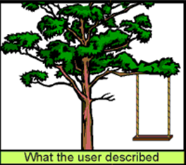
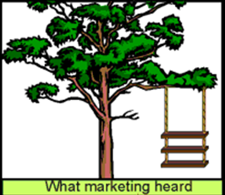
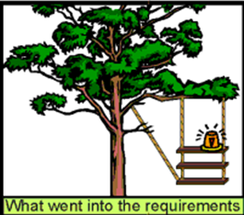
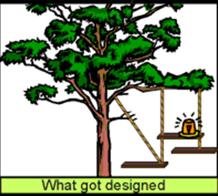
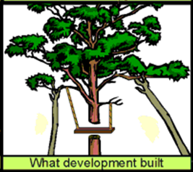
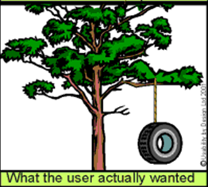

Slide 21
Spiral model
Notes:
The spiral model combines the idea of iterative development (prototyping) with the systematic, controlled aspects of the waterfall model. It allows for incremental releases of the product, or incremental refinement through each time around the spiral. The spiral model also explicitly includes risk management within software development.

Slide 22
Spiral model
Combines the idea of
iterative development (prototyping)
With systematic, controlled aspects of the waterfall model.
It allows for
incremental releases of the product
incremental refinement
explicitly includes risk management within software development.
Notes:
Identifying major risks, both technical and managerial, and determining how to lessen the risk helps keep the software development process under control

Slide 23
Reuse-oriented development
Based on systematic reuse where systems are integrated from existing components or COTS (Commercial-off-the-shelf) systems
Process stages
Component analysis
Requirements modification
System design with reuse
Development and integration
This approach is becoming more important but still limited experience with it

Slide 24
Reuse-oriented development

Slide 25
Game Production
Originally considered a software development project
It requires new skills, team members, and project structure
Artistic tasks
Content development
Story writer
Game engines also transformed game development to more “scripting” than “programming”.

Slide 26
Programming Teams
1980s programmers developed entire game (and did art and sounds too!)
Now programmers write code to support designers and artists (who are real content creators)

Slide 27
Programming Areas
Game code
Anything related directly to the game
Game engine
Any code that can be reused between different games
Tools
In house tools
Plug-ins for off-the-shelf tools

Slide 28
Game Development Team
Design
Game Designer
Level Designer Writer
Art
Art Lead
Concept, Character, Background, Animation, Texture, Sound, etc.
Producer(s)
External
Internal
Assistants
Programming
Tech Lead
AI and Logic, Physics, Effects, Sound, Tools, DB, Networking & MU, etc.
Test
Test Lead
Testers

Slide 29
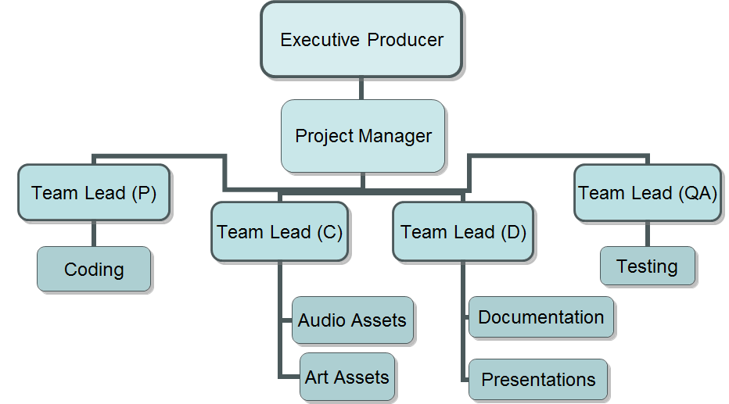
Your Team Structure (by necessity)

Slide 30
Tool-based Process
Recent trend toward “less coding”
Tools like game engines and levels editors
Use of existing libraries and GUI
Scripting instead of programming
Still needs specialized code

Slide 31
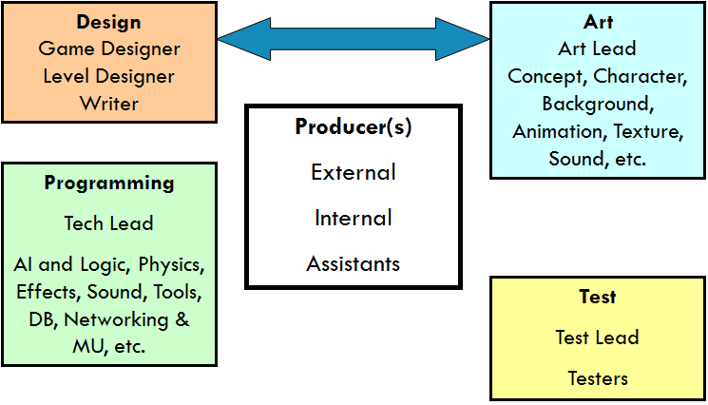
Game Producers
External
From publisher
Internal
From development company
aka project manager or director
Assistant
Assets, daily tasks (builds, backup, etc.), screenshots, PR, checking milestones, paperwork, etc.

Slide 32
Design Team
Game design requires both Talent and Skill.
Talent is innate, but skill is learned.
Anatomy of a Game Designer
Imagination
Technical awareness
Analytical competence
Mathematical competence
Aesthetic competence
General knowledge and ability to research
Writing skills
Drawing skills
Ability to synthesize
Notes:
Game designer
Play a lot of games!
Use demos and reviews, look around, chat, etc.

Slide 33
Game Designer Imagination
Imagination is essential to create a game which exists in Artificial universe
Make-believe place governed by make-believe rules
Imagination forms:
Visual and auditory
Enables to think of new building, animals, trees – how they look and sound
Dramatic
Require to create good character, plot, scenes, climaxes, etc.
Conceptual
Enables to define relationships between ideas, interactions and dependencies
Imagination includes Adaptation

Slide 34
Game Designer Technical Awareness
A general understanding of
Computer programs
Games (how they work)
Scripting language (level designer)
Knowledge of target platform

Slide 35
Game Designer Analytical Competence
Ability to study and dissect something:
An idea or a problem or an entire game design
Able to recognize good and bad parts of design
Example:
Detecting dominant (unbeatable or nearly unbeatable)

Slide 36
Game Designer Mathematical Competence
Designers must have
Basic math skills
Trigonometry
Principles of probability
Balancing games that features complex internal economics
Business simulators
Real-time strategy games

Slide 37
Game Designer Aesthetic Competence
Should have
a general aesthetic competence and sense of style
Able to set the visual tones of the game and to create a consistent and harmonious look.
Many games are visual clones of one another, depending on stereotype and clichés rather than real imagination
Watch movies that are famous for visual style!

Slide 38
Game Designer Quality
General Knowledge
Writing Skills
Drawing Skills
Ability to compromise
Be professional
Able to compromise on details and integrate a variety of opinions while preserving consistent, holistic vision of the game

Slide 39
Programming Team
Tech lead
Programmers
AI and Logic
Physics
Tools, DB, network and multi-player
Graphics effects, sound effects, weapons
Scripting languages

Slide 40
Art Team
Art director
Artists
Concept
Character modeling
Background modeling
Animation
Texture
Sound, etc

Slide 41
Externals
Music
Voice
Sound effects
Video
Motion capture
Language localization
Legal, manual, etc.

Slide 42
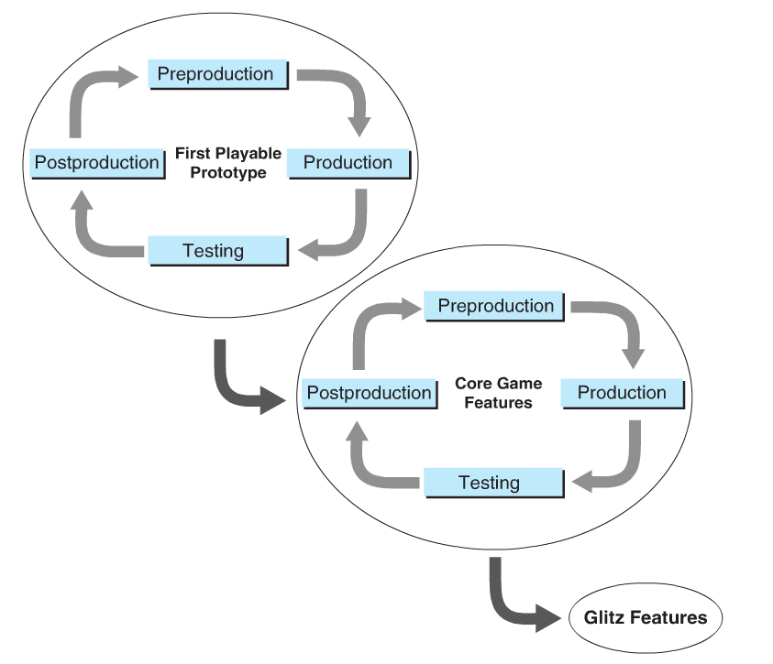

Production Lifecycle
Concept development and design
Pre-production (proof of concept)
Production
Test (alpha and beta)
Release (after code freeze)
Maintenance
Upgrade
Notes:
Fundamentals of Game Development
Heather Maxwell Chandler, Rafael Chandler

Slide 43
Concept Development
Taught Earlier
Lecture 3 and 6

Slide 44
Concept development
Can we change everything?
The followings are decided once at the beginning and not changed.
Choice of concept
Target Audience
Genre

Slide 45
Pre-Production
It proves that your team can make the game, and that the game is worth making - Proof of Concept
The tasks are:
Complete the game design
Create Art bible
Establish production path
Write up the project plan
Finally build a prototype
Notes:
Preproduction is gearing-up time.
Your goal is to complete the game design, create the art bible, establish the production path, write up the project plan, and create a prototype.
This phase is also where you do some technical prototyping that demonstrates the feasibility of any new technology you hope to deliver.

Slide 46
The Game Design Document
A game design document exhaustively details everything
Available by the end of preproduction
GDD becomes a requirement from which you make
The art production plan and
The technical plan

Slide 47
The Game Design Document
During the development cycle
Always keep it up-to-date (online, e.g. wiki pages)
Accessible by all team members
GDD has complete information (with finest detail) about
gameplay
user interface
story
characters
monsters
AI, and everything else

Slide 48
The Art Production Plan
Preproduction is when you establish the “look” of your game and decide how the art will be created.
The Art Bible
The production path
Assets, Budgets, Task, and Schedules

Slide 49
The Art Bible
Set the artistic style of the game
Members: designer, art director, and concept artist
Make sure a consistent style throughout
Most of art can take the form of
pencil sketches, but it is often useful in selling the game to develop a few glossy pieces that capture the high concept and pack a good visual punch
The concept artist makes reference sheets for other artists to work from

Slide 50
The Art Bible
A good idea
assemble a visual reference library of images that reflect the direction you want the art to take.
Source of images can be
magazines, travel books, movie posters, and so on—as long as they’re used only for guidance and don’t find their way into the final product.

Slide 51
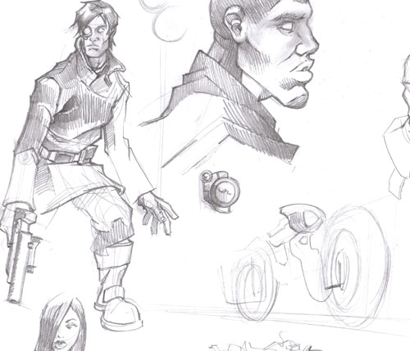
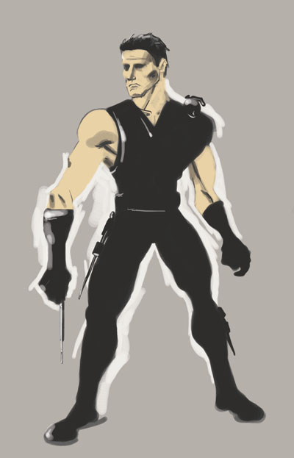
Examples of Concept Art

Slide 52
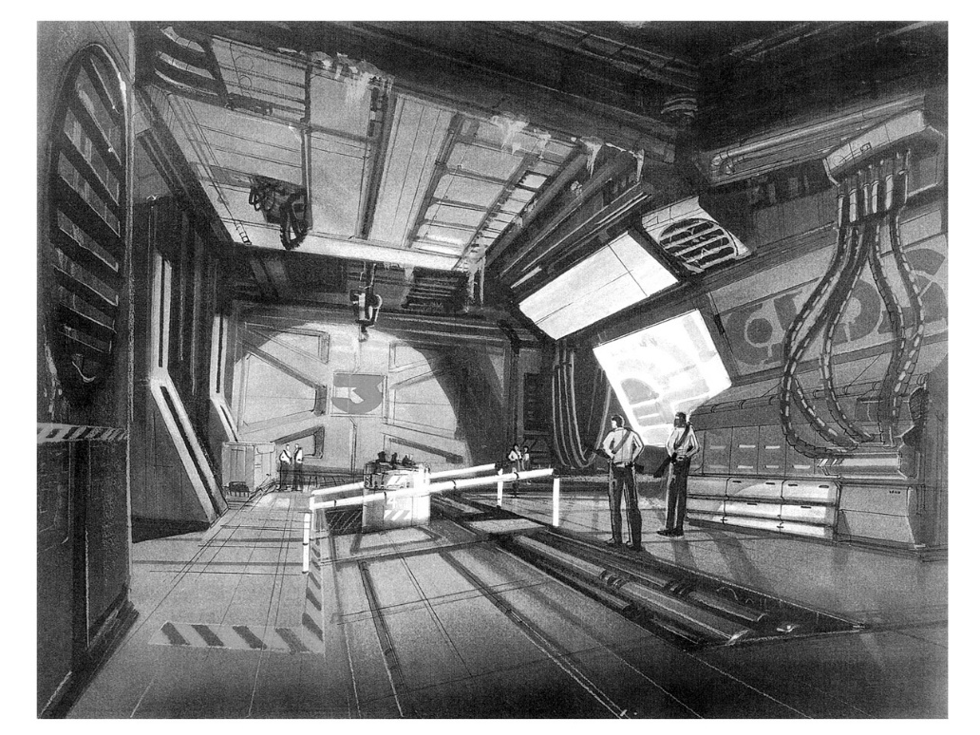
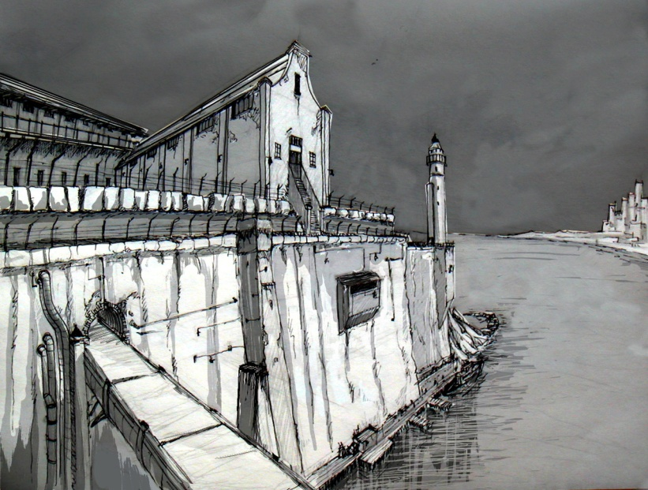
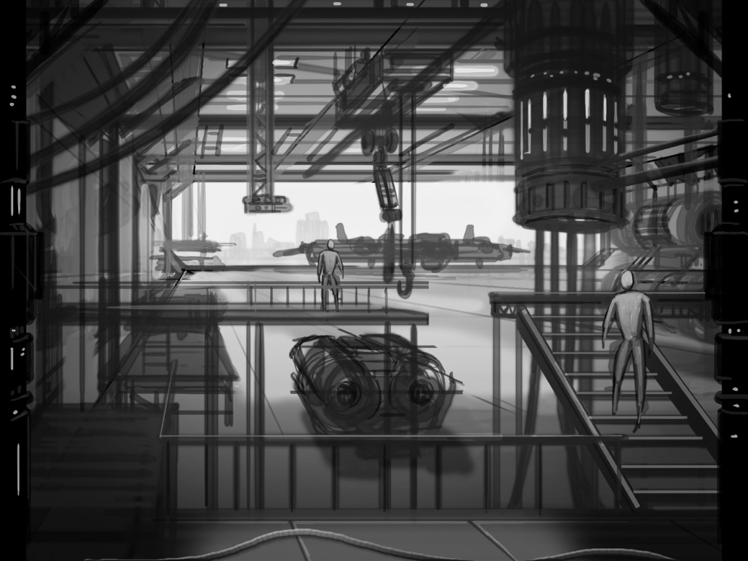
Examples of Concept Art

Slide 53
Example: Create a functioning character in an action game
Designer’s spec
Concept sketch
3D model
Skin for the model
Animation for the figure
AI to the character
Dropping him into the game
Notes:
All the tools you select along the way must be compatible.

Slide 54
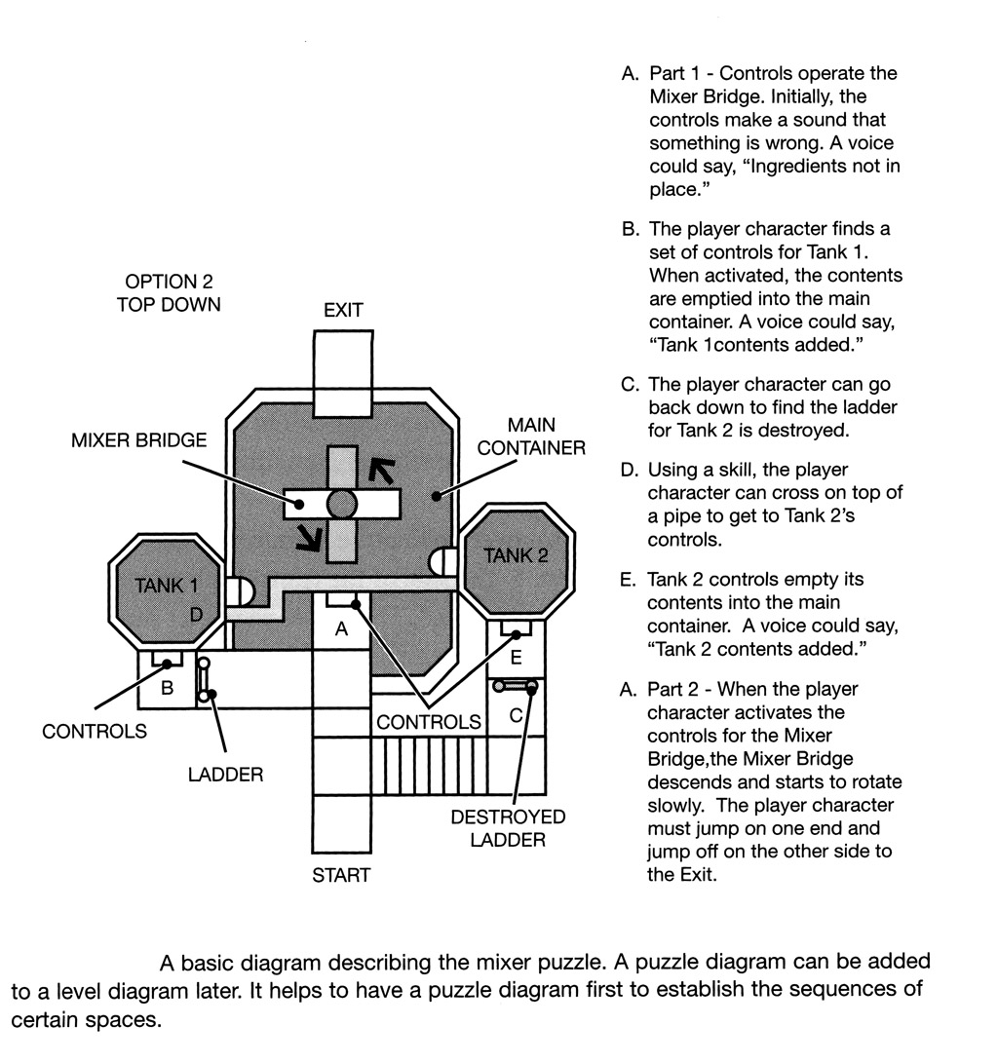
Example: Puzzle Design

Slide 55
Production Path
A process by which you go
from concept to reality
from an idea to actual figures and gameplay on the screen.
Points to note:
All the tools must be compatible (why?)
work on one step can be imported to the next step, manipulated, and passed up the line.

Slide 56
Assets, Budgets, Task, and Schedules
The Production Plan also includes the first draft of
the asset list
team tasking
Equipment
budget and costs, etc.

Slide 57
The Project Plan
A roadmap
that tells you how you’re going to build the game
It covers:
Manpower Plan
A spreadsheet –
lists all the personnel, when they will start, and how much of their salaries will be applied to the project
Resource Plan
Calculates external costs
Hardware purchases
Support personnel
Cost of voice, music, video, and so on

Slide 58
The Project Plan
Project Tracking Doc
keep track of whether you’re on schedule
Use project management software (may not cover all aspects of a game)
Create a Gantt chart that reveals dependencies and the critical path (CPM)
Budget
P&L (Profit and Loss Statement)
Development Schedule
Milestone Definitions

Slide 59
Production
Similar to design and implementation phases in software development.
Lifecycle models
Waterfall
Modified waterfall
Iterative
More suitable and common
Rapid iterative prototyping
XP, Agile, etc.

Slide 60
Testing
Gameplay functionality
Unit/character functionality
Story progression
User interface
Sound and music
Compatibility
Gold master/final checklist

Slide 61
Test-related Versions
Alpha – The beginning of the end
At which the game is mostly playable from start to finish.
a few workarounds or gaps
not all the assets might be final,
The engine, user interface, and all other major subsystems are complete
Closed Beta
No severe defects
Open Beta
Public access for test
Release
Notes:
Alpha - At which the game is mostly playable from start to finish. There might still be a few
workarounds or gaps, and not all the assets might be final, but the engine, user interface,
and all other major subsystems are complete

Slide 62
Publishing
Public relations (PR)
Marketing
Sales
Stores
Distributors
Original Equipment Manufacturer (OEM)
Promotion

Slide 63
References
Textbook
Game Design, 2e
Bob Bates
Thomson, 2004
Game Producer’s Handbook
Dan Irish
Thomson, 2005
Some information and images are taken from the different online sources, only for educational purpose. I acknowledge them.

Slide 64
Thank you!

